Slide 1


AICT INTERNSHIP PROJET PRESENTATION ON
Deforestation detection
PRESENTED BY:
Mr.Aryan Sopan Surve.
AICTE Student ID: STU67946d501b2821737780560
AICTE Internship ID: INTERNSHIP_1748923002683e727a876ea

Slide 2

Learning Objectives
By the end of this presentation, the audience will be able to:
✅ Define deforestation and explain its environmental impact.
🛰️ Understand how remote sensing and GIS are used to detect deforestation.
🤖 Recognize the role of machine learning in analyzing satellite images.
🔁 Describe the workflow of an automated deforestation detection system.
📊 Interpret results and accuracy metrics from detection models.
🌍 Identify real-world applications and challenges in forest monitoring.
🛠️ Explore current solutions and future directions for forest protection using
GOAL
Source :
www.freepik.com/

Slide 3
Tools and Technology used
Machine Learning & Python Libraries
scikit-learn, TensorFlow, Keras, PyTorch
Algorithms:
Random Forest, SVM, CNN, LSTM
📊 Data Processing & Visualization
OpenCV – image processing
Matplotlib / Seaborn – graphing results
Power BI – dashboards (optional)

Slide 4
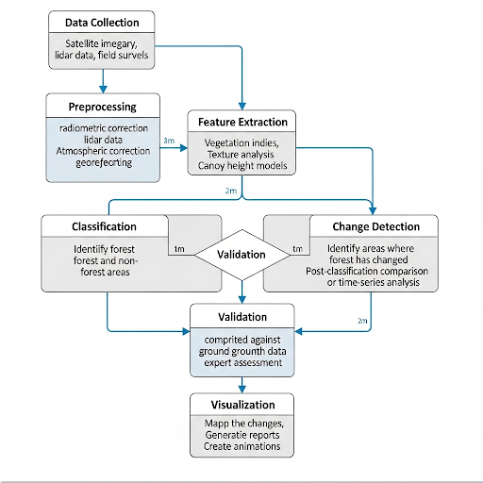
Methodology

Slide 5
Problem Statement:
Deforestation is occurring at an alarming rate across the globe, threatening biodiversity, contributing to climate change, and impacting local communities. Traditional monitoring methods are slow, manual, and often lack accuracy, making it difficult to detect forest loss in a timely manner.
There is a critical need for an automated, accurate, and real-time deforestation detection system that can analyze satellite imagery using modern technologies like remote sensing, GIS, and machine learning to support forest conservation efforts and policymaking.

Slide 6
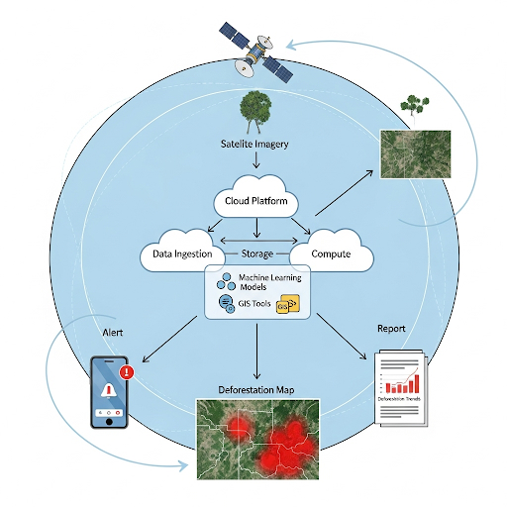
Solution:

Slide 7
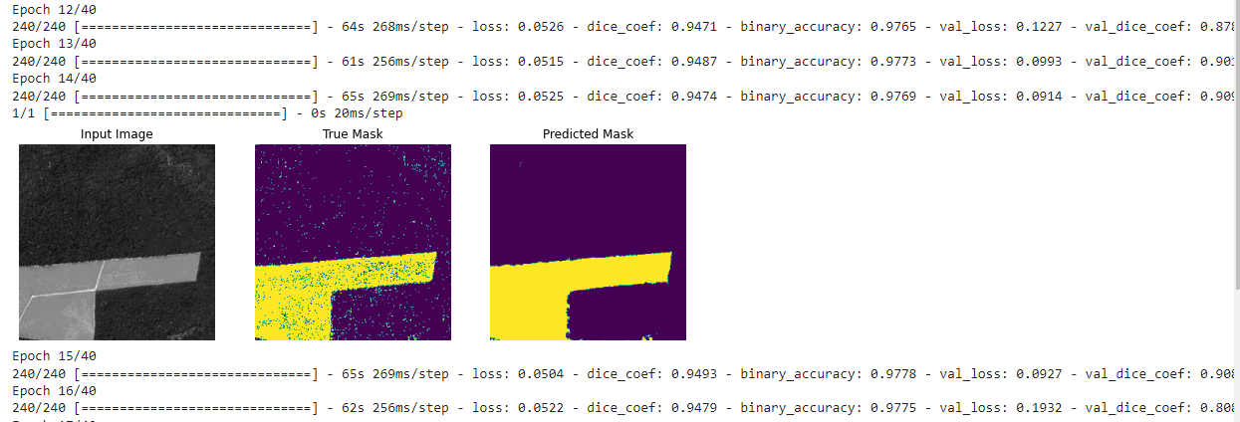
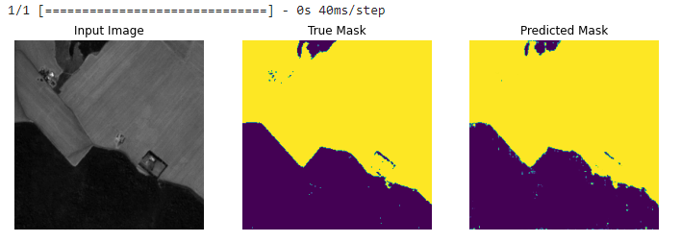
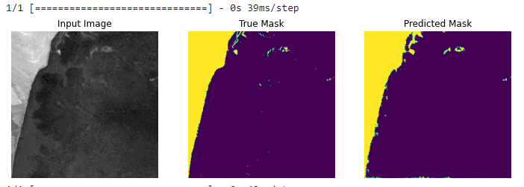
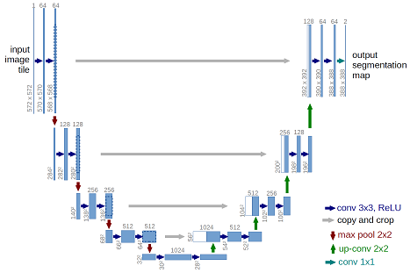
Screenshot of Output:

Slide 8
Conclusion:
Deforestation poses a serious threat to the environment, climate, and biodiversity.
🛰️ Modern technologies like remote sensing, GIS, and machine learning enable efficient and accurate forest monitoring.
⚙️ An automated detection system can provide real-time insights, helping in early intervention and better decision-making.
🧠 Integrating AI with satellite imagery is a powerful tool for conservation efforts.
✅ With proper implementation, this solution can support sustainable forest management and protect natural ecosystems for future generations.

Slide 9
THANK YOU
Edunet Team
For Giving wonderfull opportunitie

